Slide 1
Project Elaboration Phase 3
Presented By:
Ger Xiong
J’enderson Xiong
Liz Wronski

Slide 2
Vision
Since there are many components involved in a functioning catering company, there needs to be a centralized system for organization and communication.
We want to create a management system to process catering orders and organize them in a way for multiple entities of the catering team to access and use.

Slide 3
Scope
The catering management system will allow for customer orders to be effortlessly entered into an database where the information can then be accessed by other users of the system. In-depth Information about each order will be communicated through the system.

Slide 4
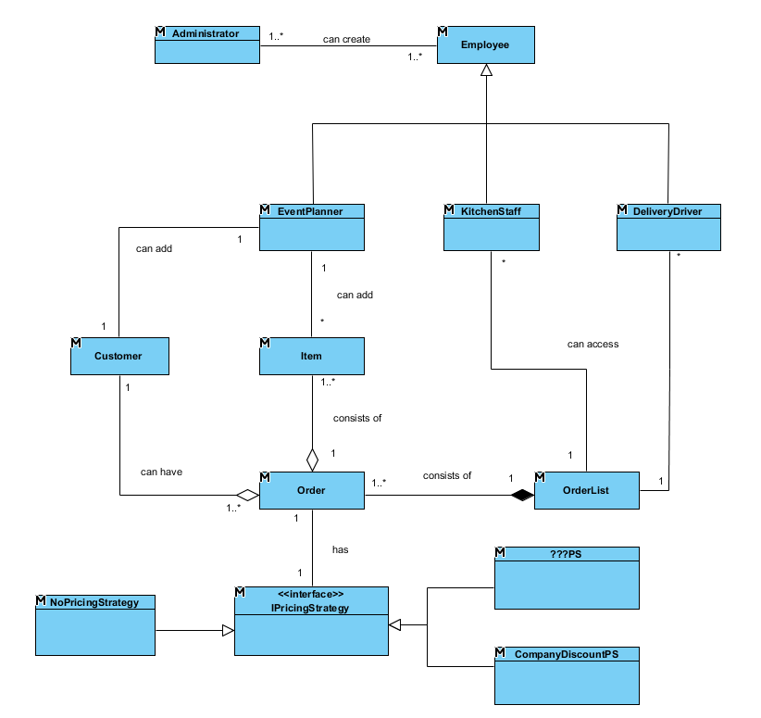
Domain Model

Slide 5
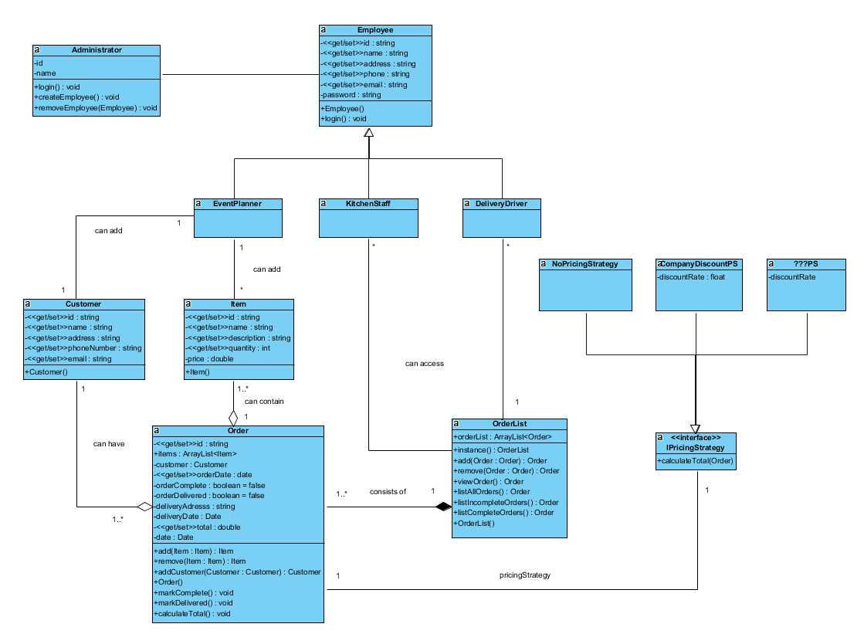
Design Model

Slide 6
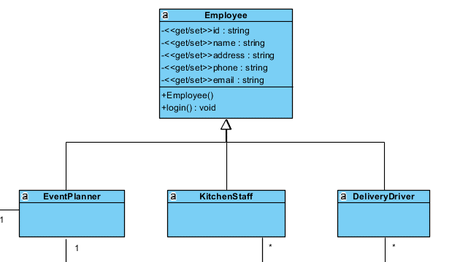
Polymorphism
Each of the employee objects contain the same attributes, demonstrating polymorphism with varying task specific

Slide 7
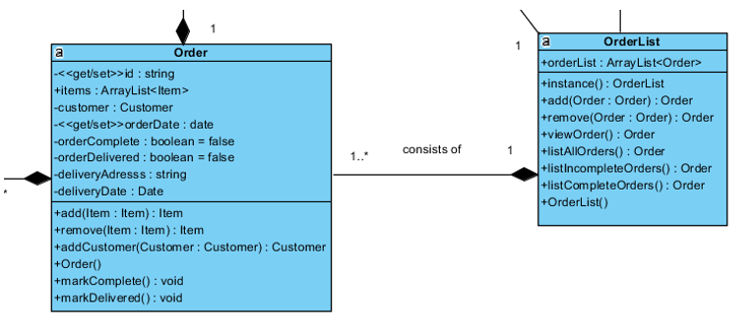
Singleton
Orderlist is a singleton of the system. This sole instance is easily accessible by the kitchen staff and delivery drivers

Slide 8
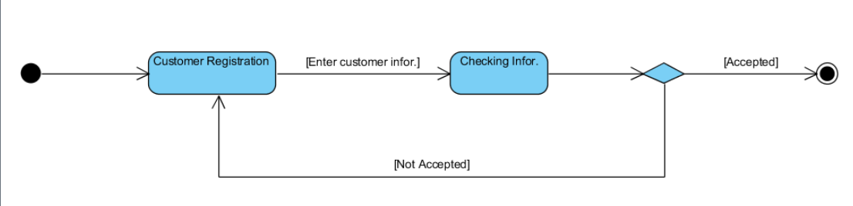
State Diagram Customer Registration

Slide 9
State Diagram Login

Slide 10
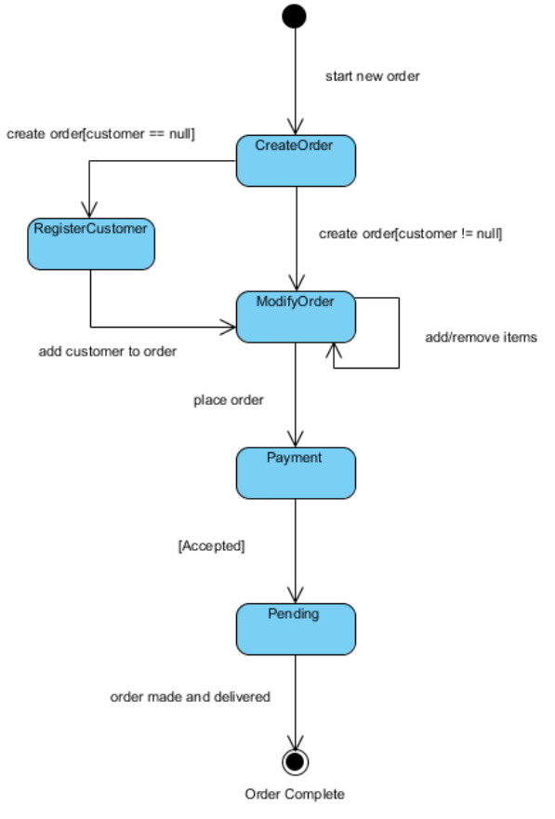
State Diagram
New Order

Slide 11
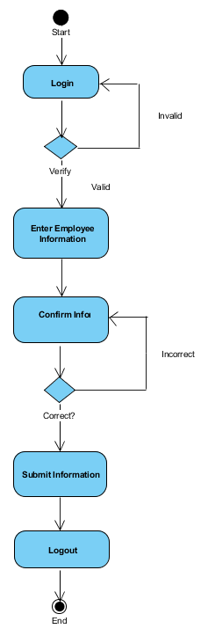
Activity Diagram
Employee Registration

Slide 12
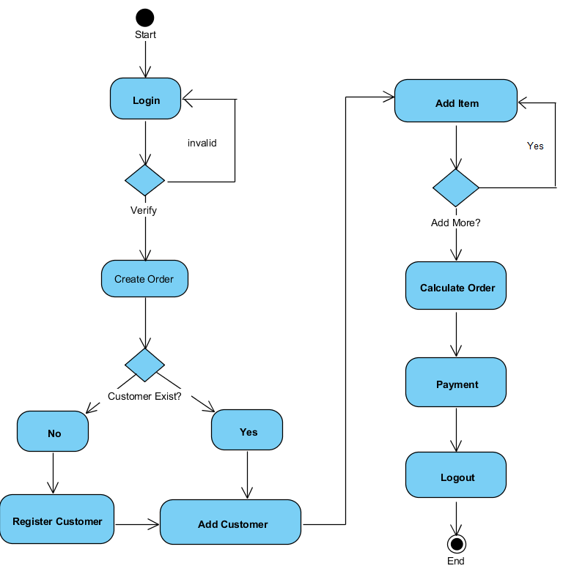
Activity Diagram
New Order

Slide 13
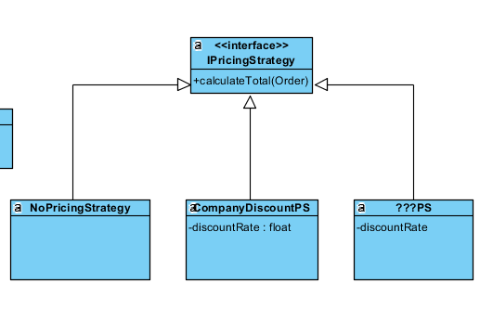
Strategy
By implementing strategy design pattern, order prices can be adjusted to reflect certain promos or discounts while adding new pricing strategies can be done without sacrificing cohesion

Slide 14
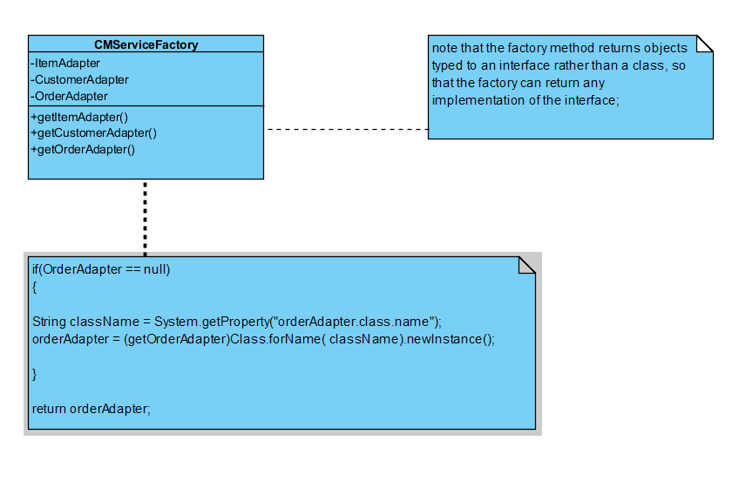
Factory
A function or method that returns objects of a varying prototype or class from some method call.
Interfaces that accept a constructor can also in general accept a factory method.

Slide 15
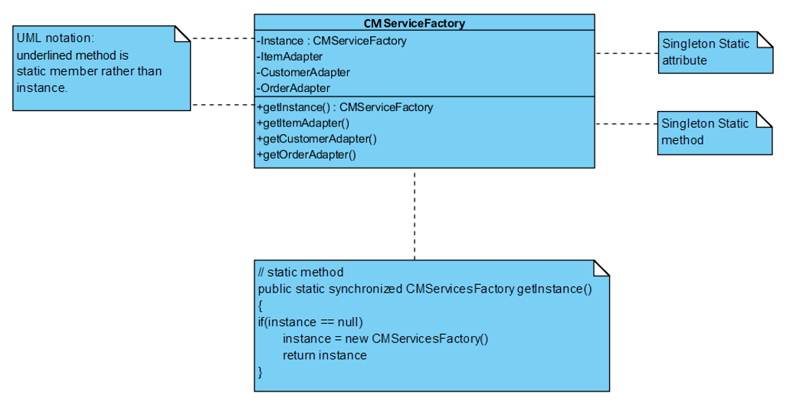
Singleton
Only one object is needed to coordinate action across the system.
CMS will operate more efficiently when only one object existed.

Slide 16
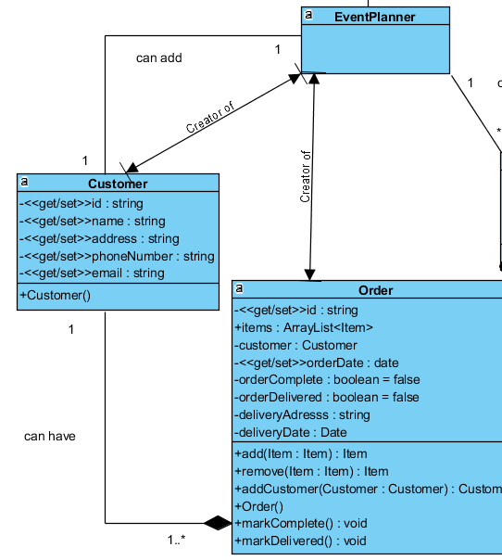
Creator
Event Planner creates new Customers and new Orders

Slide 17
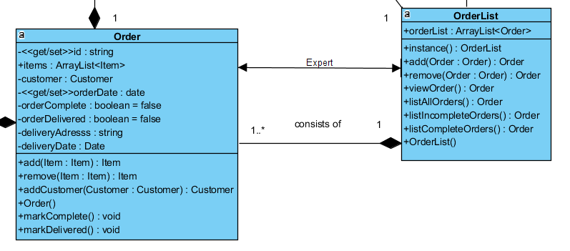
Information Expert
Order is the Information Expert for OrderList.

Slide 18
Software Architecture Document
Introduction
Vision: Create a management system to process catering orders and organize them in a way for multiple employees to access and use them.
Scope: The system will allow for orders to be organized in a database where the information can be accessed by other users of the system.
Architectural Representation
The document represents the system architecture through several views including Use Case, Logical, Process, and Deployment.

Slide 19
Software Architecture Document
Architectural Goals and Constraints
High performance interface that can handle multiple personnel use at the same time
Database is dependable, showing order updates in real time
Security of the system is up-to-date ensuring protection of employee and customer data
Use Case View
Describes the sequences of iterations between objects and between processes.
Event Planner: creates new customer and a new order connected to that customer
Kitchen Staff: accesses all orders through the order list for production
Delivery Driver: accesses all orders through order list for delivery times

Slide 20
Software Architecture Document
Logical View
As shown in the Design Model, the management system is made up of several packages including
Employees: Event Planner, Kitchen Staff, Delivery Drivers
Customer: Person purchasing the product
Item: Item to be added to the order
Order: A single order for one customer
OrderList: A list of all orders in the system
Process View
Deals with the dynamic aspects of the system and how each process communicates with each other
Deployment View
Physical deployment of processes and components to processing nodes, and network configuration between nodes

Slide 21
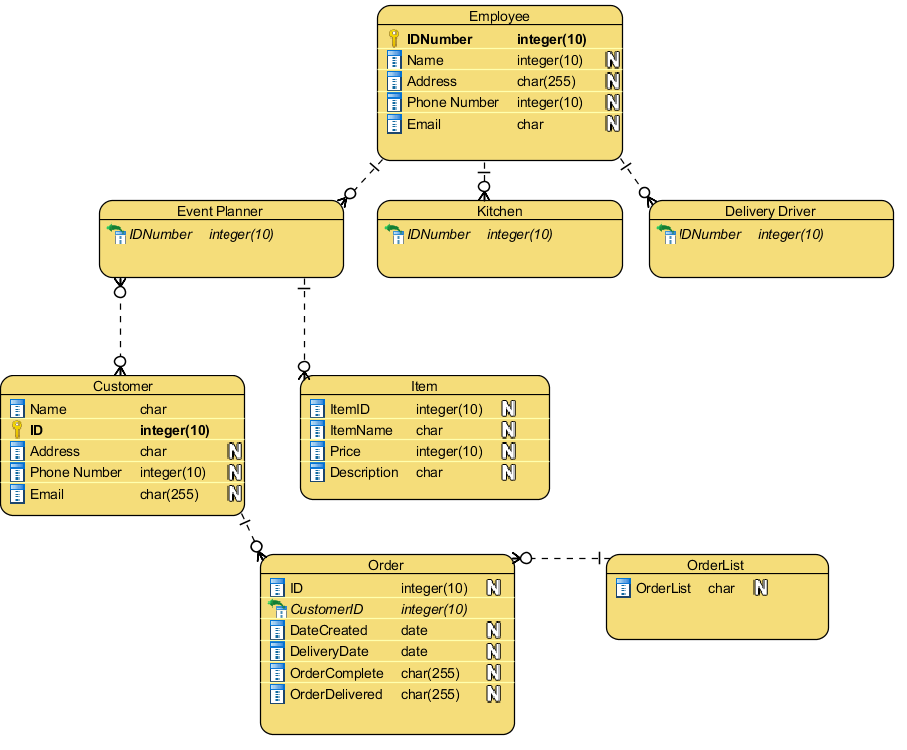
Data Model

Slide 22
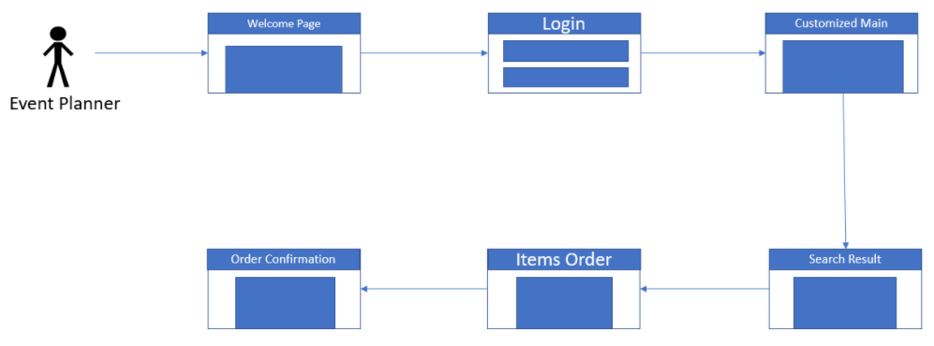
Use Case Storyboard ____________ Event Planner

Slide 23
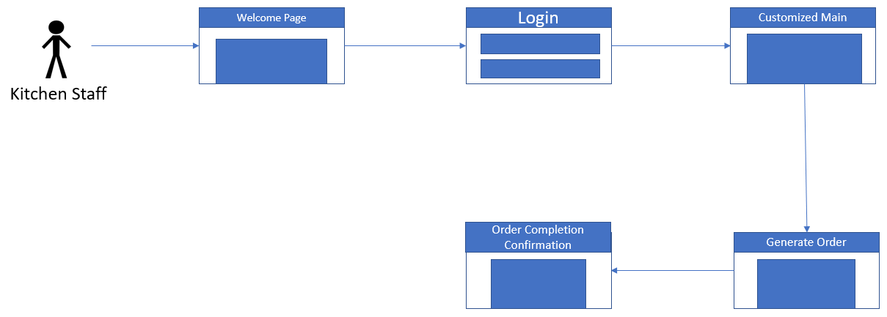
Use Case Storyboard ____________ Kitchen

Slide 24
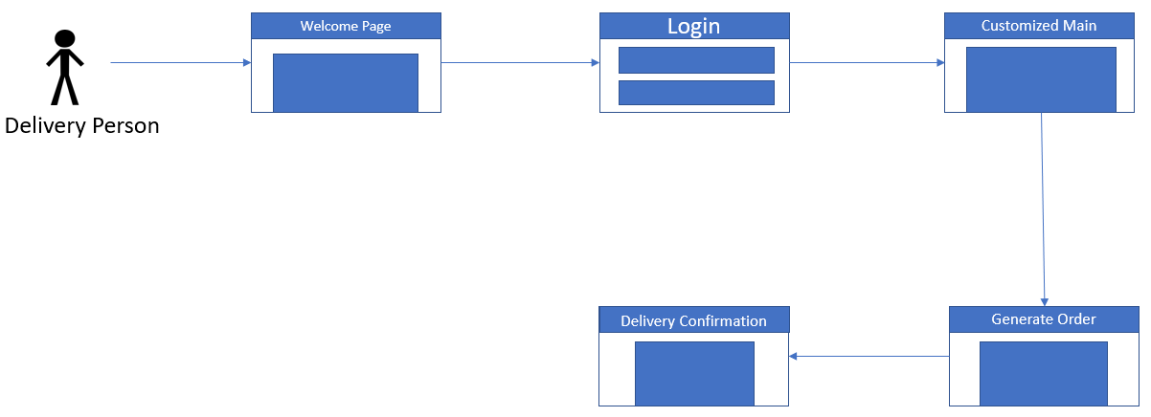
Use Case Storyboard ____________ Delivery Driver

Slide 25
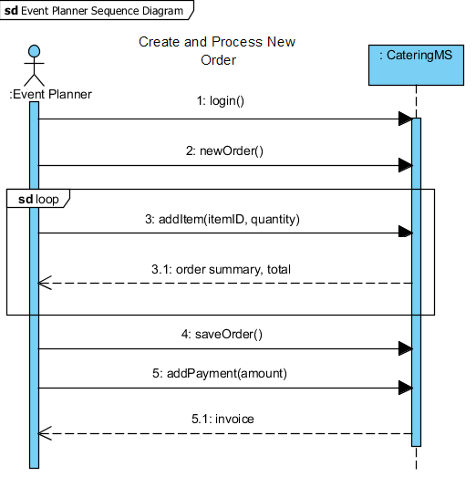
System Sequence Diagram Event Planner

Slide 26
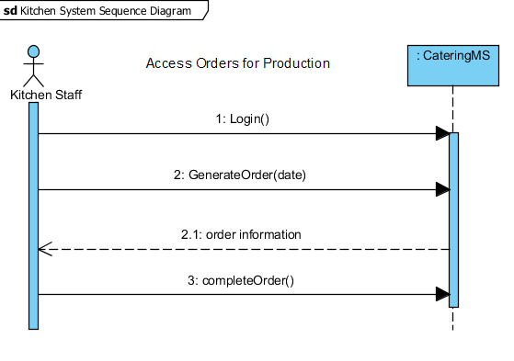
System Sequence Diagram Kitchen

Slide 27
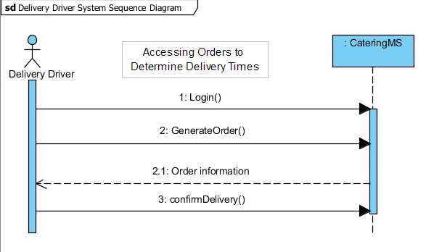
System Sequence Diagram Delivery Driver

Slide 28
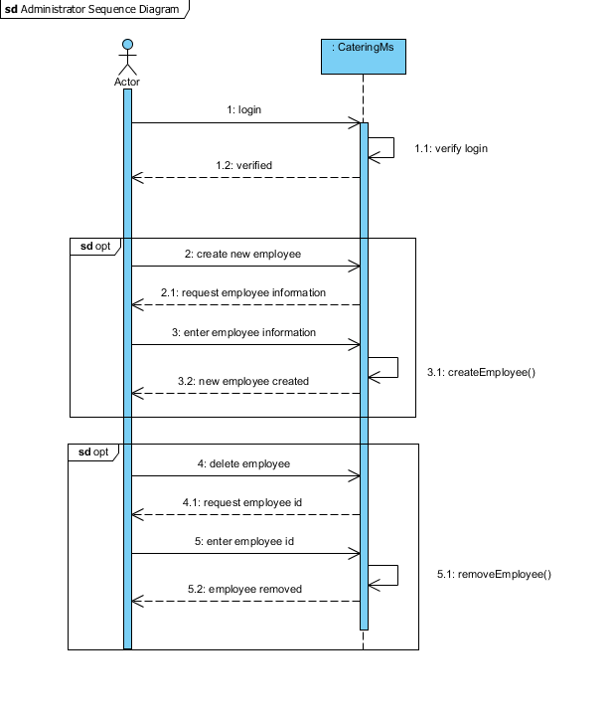
System Sequence Diagram Administrator

Slide 29
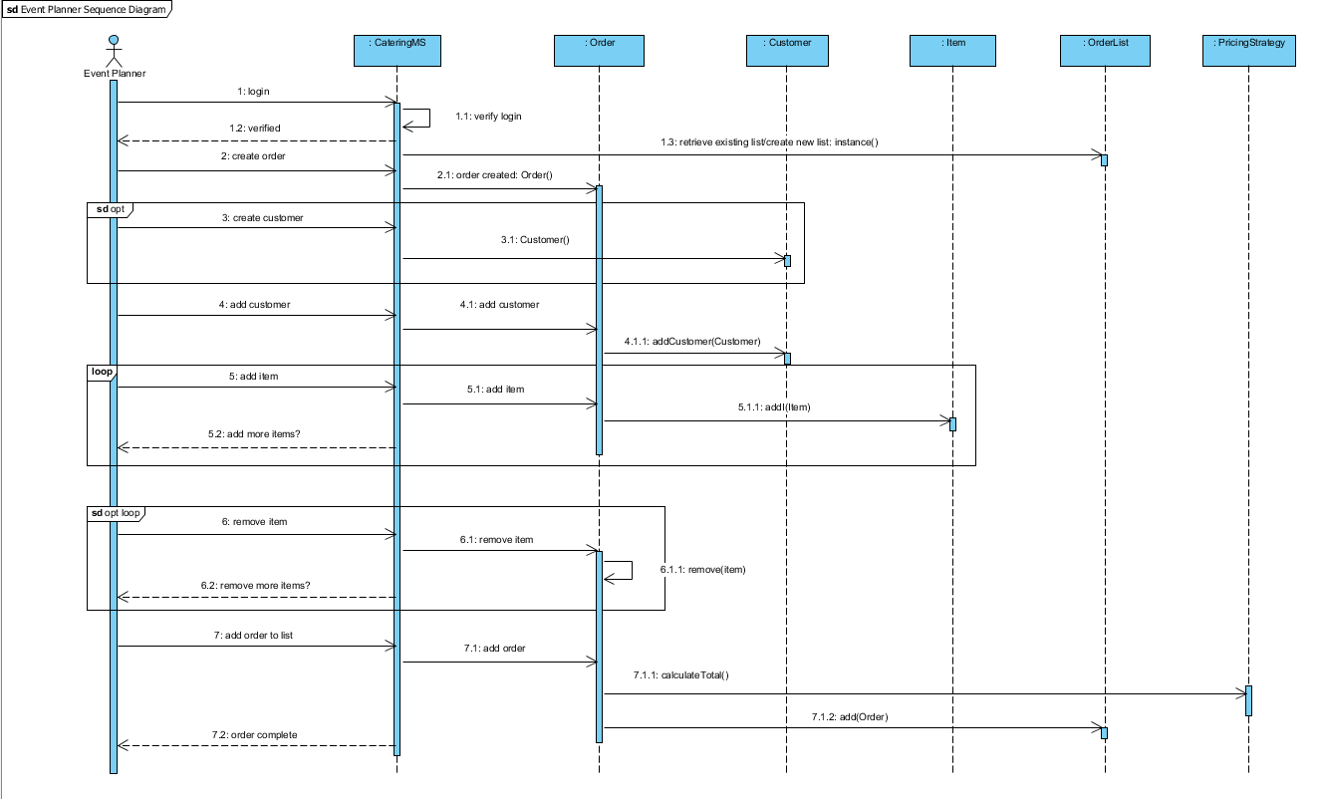
Sequence Diagram ___________ Event Planner

Slide 30
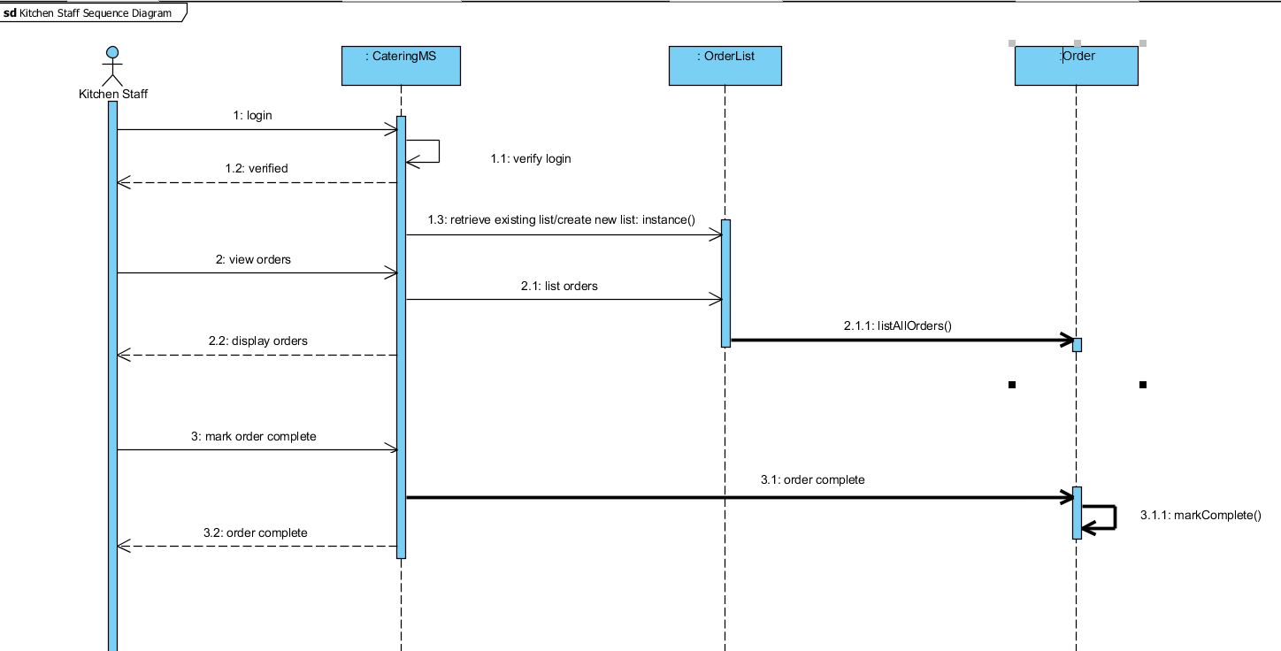
Sequence Diagram __________ Kitchen

Slide 31
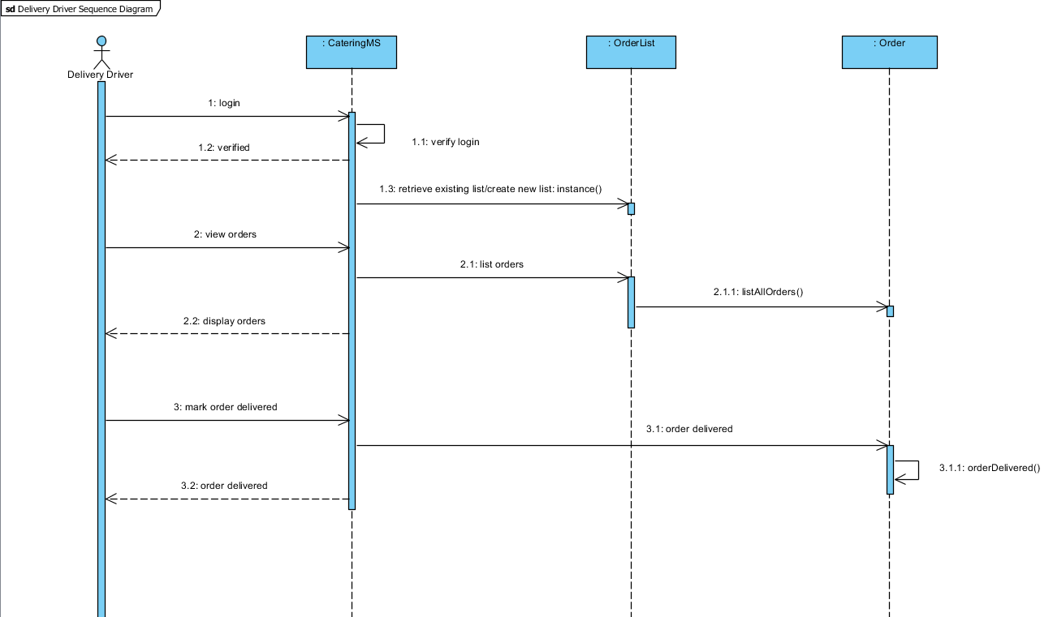
Sequence Diagram ____________ Delivery Driver

Slide 32
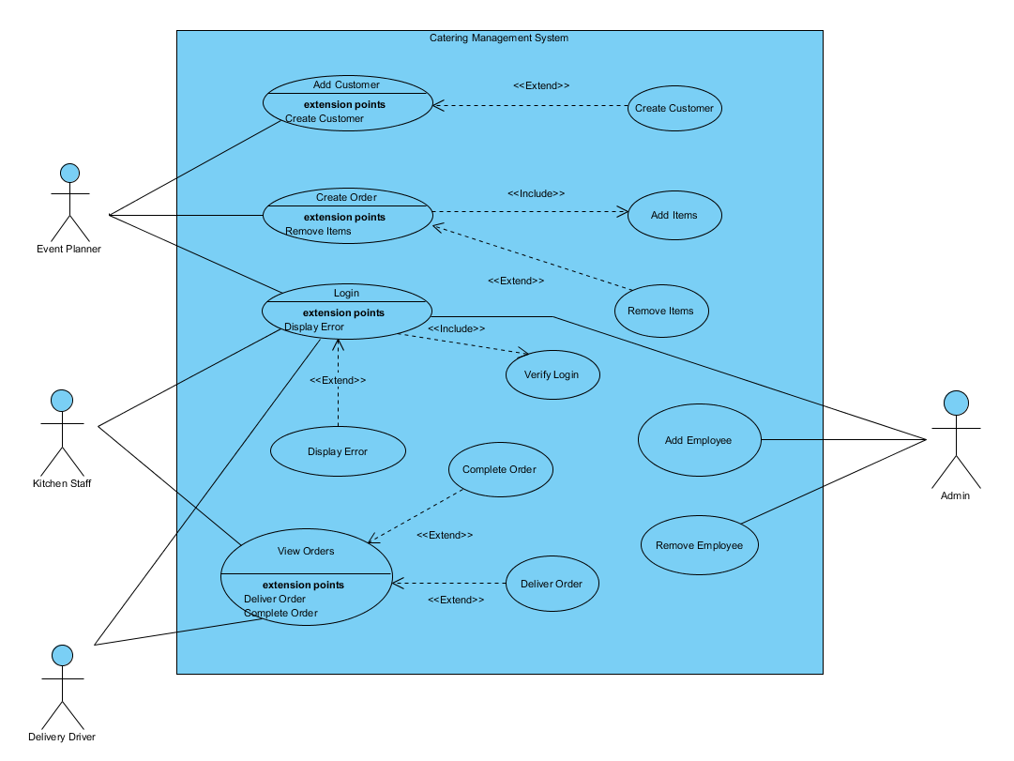
Updated Use Case

Slide 33

Questions

